Slide 1
Phys320 Catching events in a differential equation (simulation)

Slide 2
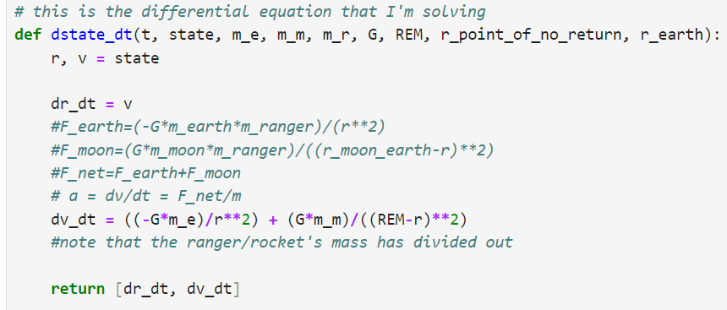

Ranger 7 mission, solve_ivp

Slide 3
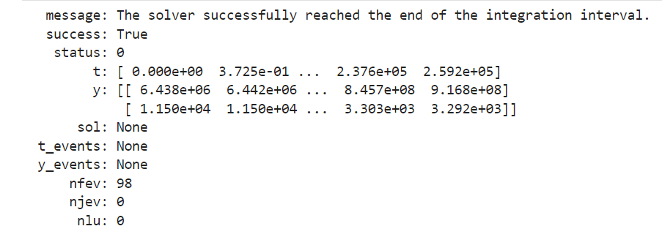






What’s wrong with this simulation output?

Slide 4
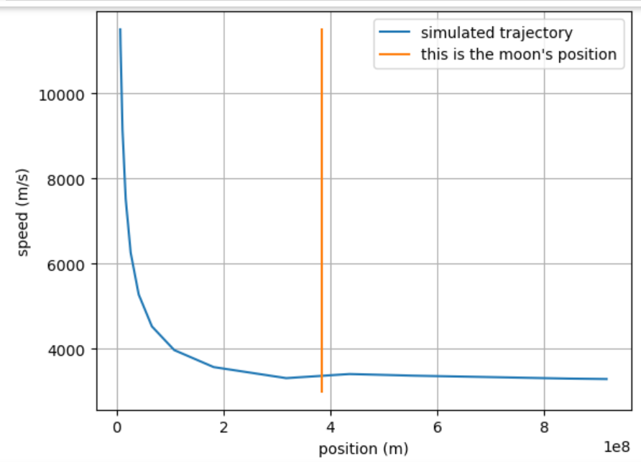

What’s wrong with this simulation output?

Slide 5
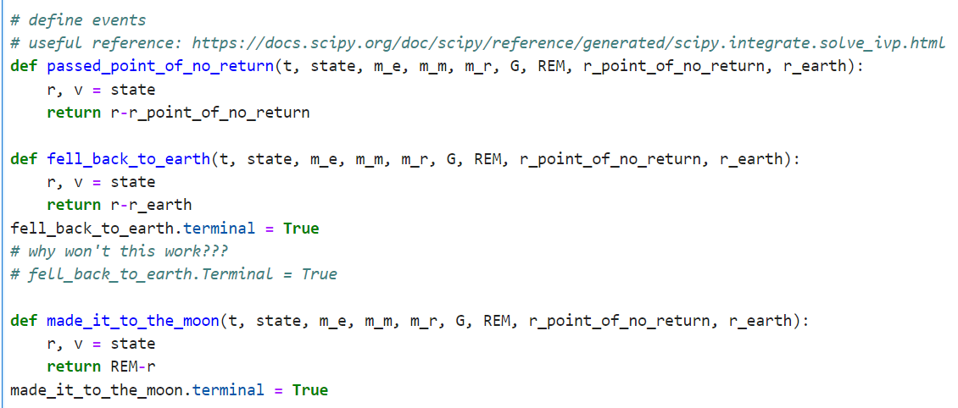

The simulation should stop when…

Slide 6
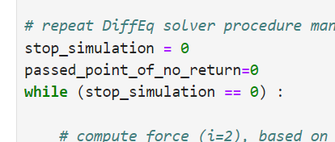
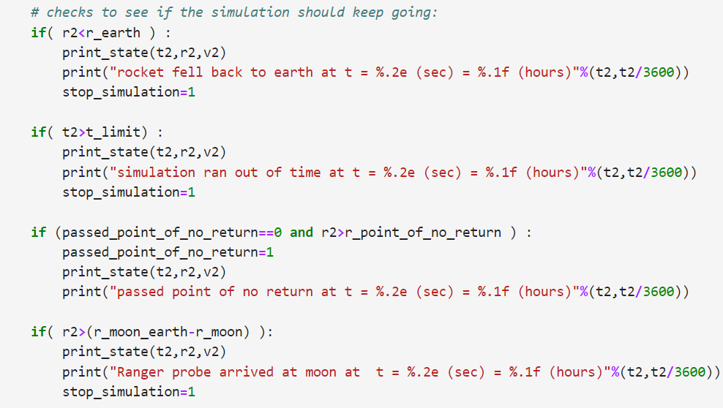



What does this look like in Velocity-Verlet?

Slide 7
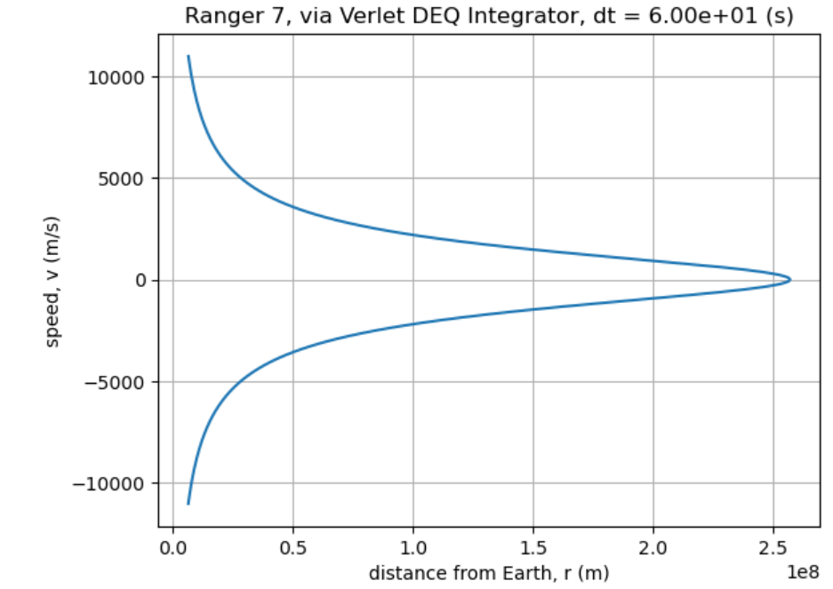

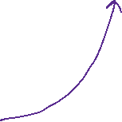











What happened?
Notes:
H

Slide 8


A Termination event occurred…
Which event?

Slide 9
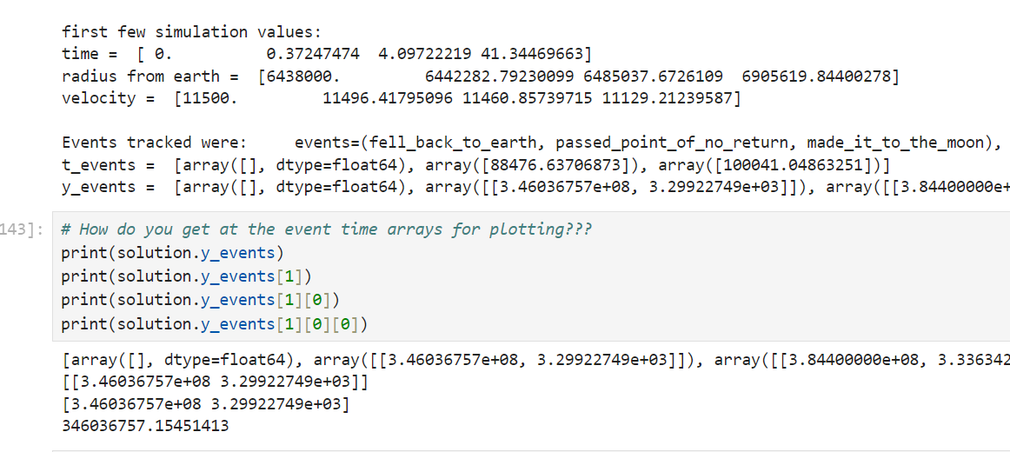




How do you get at the time/location/velocity of a termination event?

Slide 10
